Slide 1
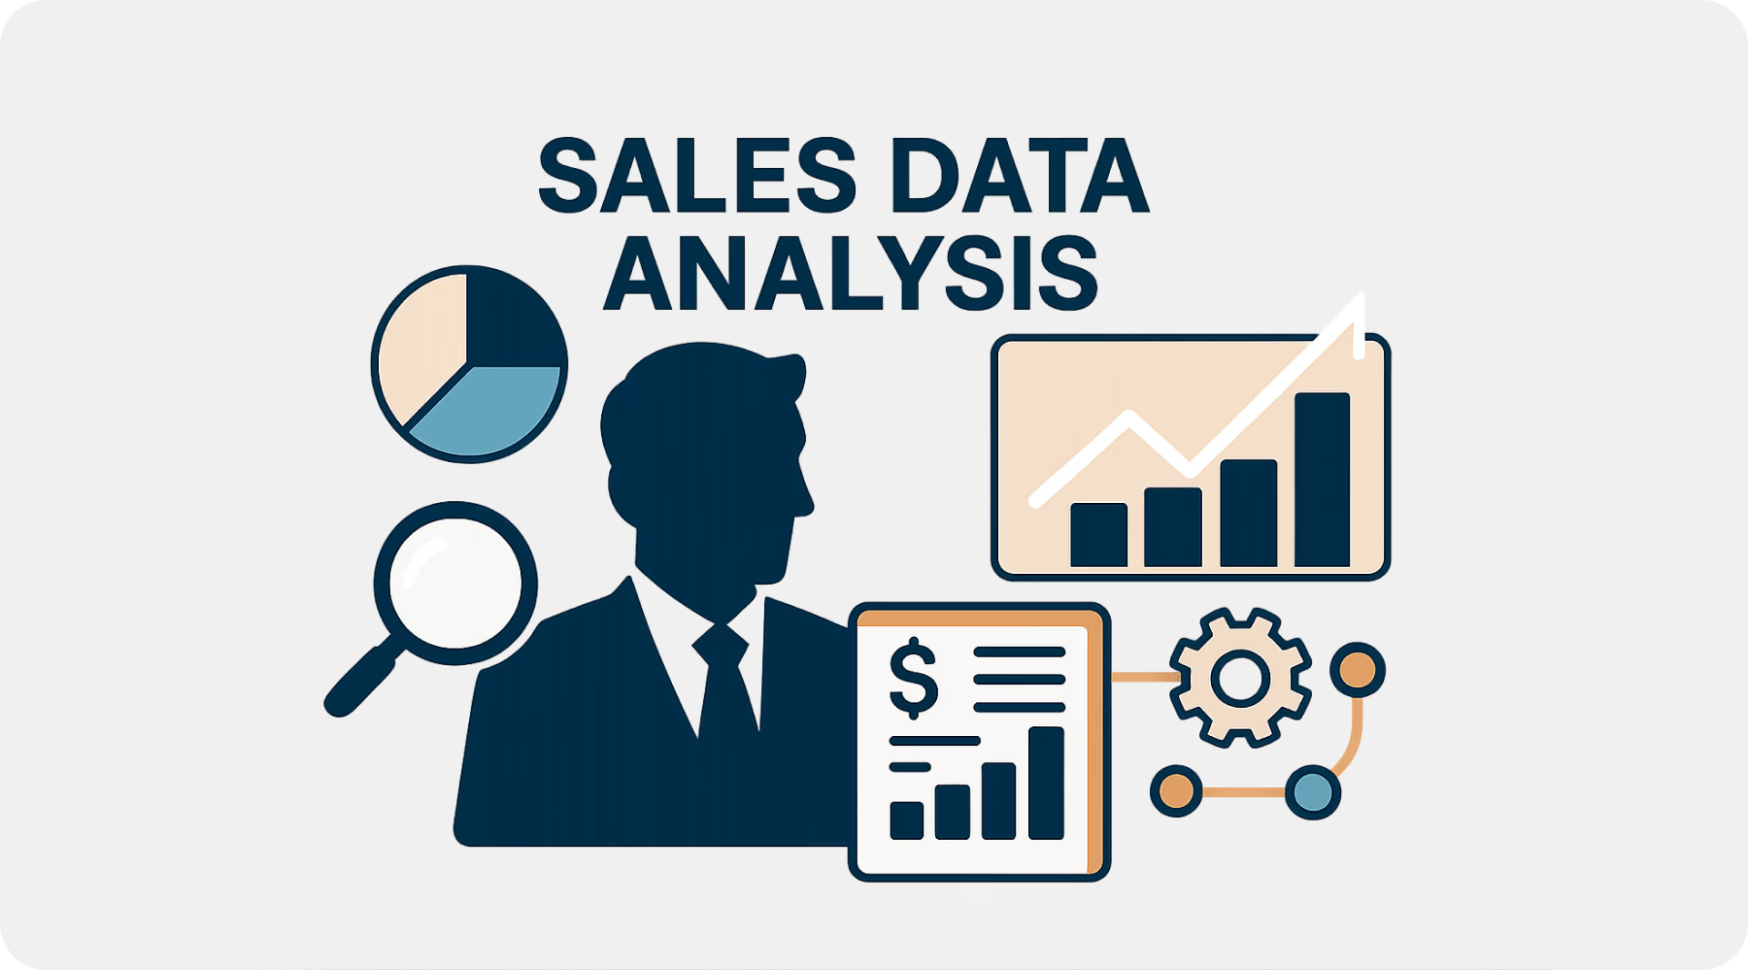
Project 1: Sales Data Analysis
Coding Samurai Internship
Created by:-Saniya Shaikh

Slide 2
Objective
The objective of this project is to perform simple data analytics on a retail sales dataset by applying basic data cleaning, descriptive statistics and visualizations.
The goal is to understand sales patterns, customer demographics, and product category performance through bar charts and pie charts.

Slide 3
Dataset Used
Retail sales dataset (CSV) from Kaggle-
https://www.kaggle.com/datasets/mohammadtalib786/retail-sales-dataset
Dataset Overview :
Total Rows: ~1,000 transactions
Total Columns: 10 fields
Main Features:
  Transaction ID
  Date
  Product Category
  Quantity, etc

Slide 4
Tools Used
Excel / Google Sheets
Basic statistics functions
Charts: Bar chart, pie chart, line chart

Slide 5
Steps Performed
1. Cleaned dataset (removed null values, corrected formatting).
2. Calculated Total Sales (Quantity × Price).
3. Created pivot tables for category-wise analysis.
4. Built bar charts and pie charts.

Slide 6
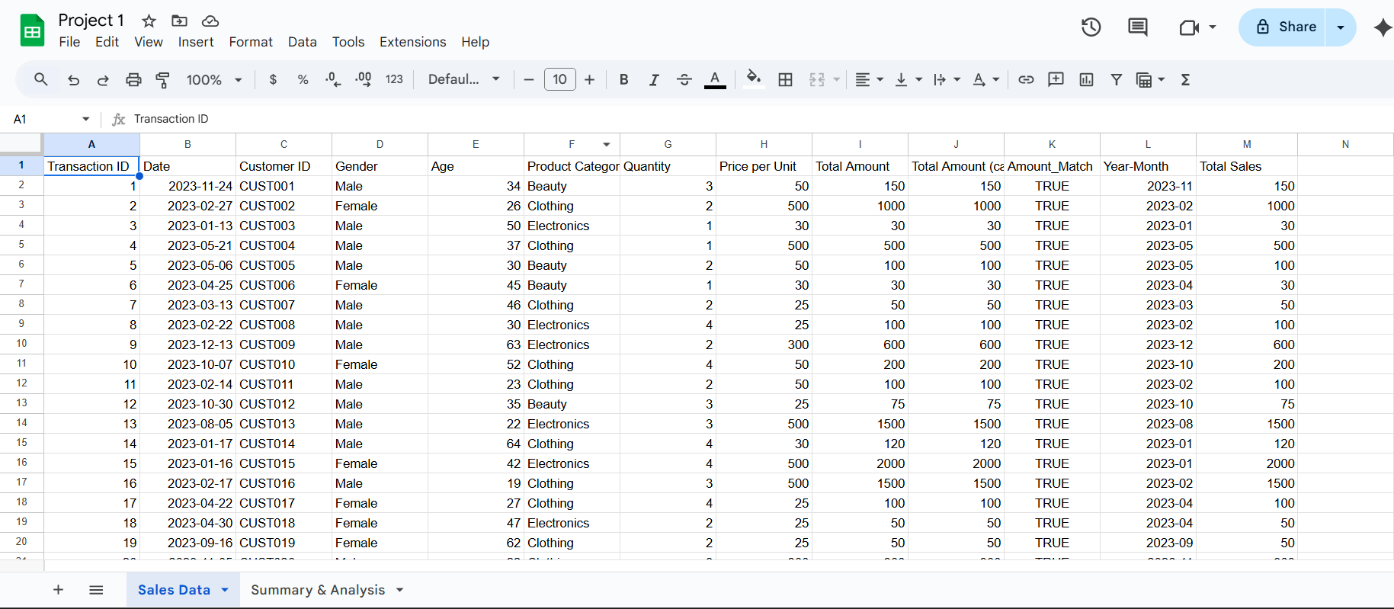
Preprocessing
Data Cleaning & Preparation
Removed/validated missing values (age/fare etc.)
Created Total Sales = Quantity × Price per Unit
Extracted Year-Month for time aggregation
Created Total Transactions, Total Quantity, AOV(Average Order Value) KPIs

Slide 7
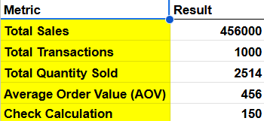
Key APIs
Key Performance Indicators:
Total Sales: 456,000
Total Transactions: 1000
Total Quantity Sold: 2514
AOV: 456

Slide 8
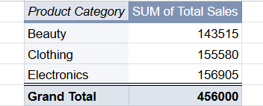
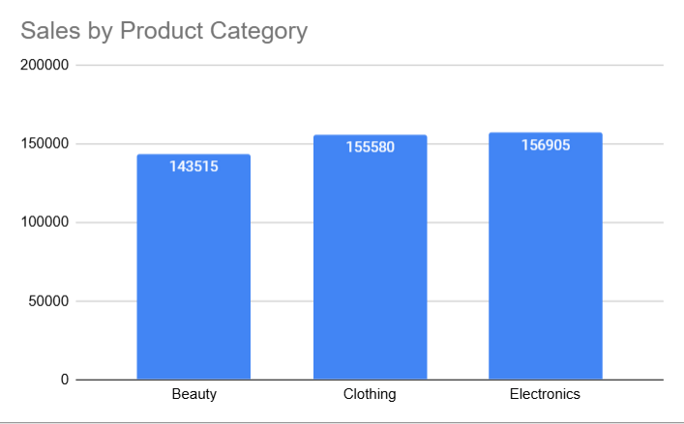
Sales by Product Category
Short insight : Clothing & Electronics lead sales; Beauty follows closely

Slide 9
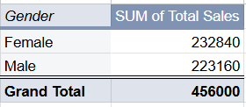
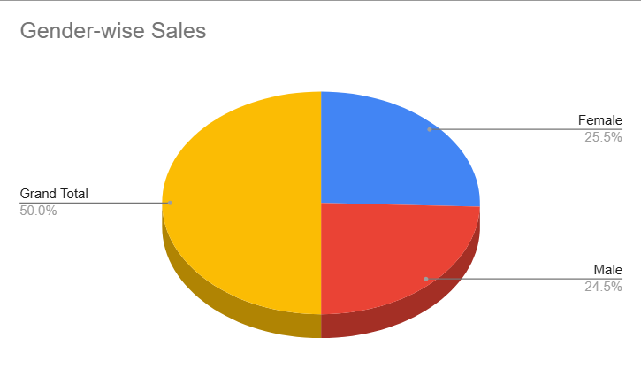
Gender-wise Sales Contribution
Short insight : Female vs Male contribution — shows nearly balanced split with slight female edge

Slide 10
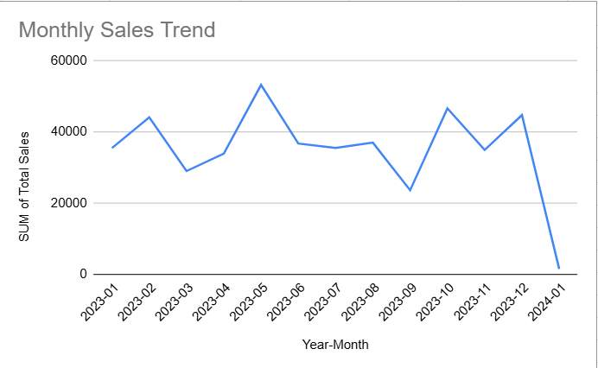
Monthly Sales Trend
Short insight : Seasonal fluctuations with peaks in May and October

Slide 11
Results & Insights
Focus marketing on Clothing & Electronics (highest sales)
Consider promotions in months with lower sales to smooth demand
Monitor AOV — cross-sell to raise purchase value
Collect customer demographics to enable targeted offers

Slide 12
Conclusion
Successfully analyzed retail sales dataset using Google sheet.
Created clear visual insights for business understanding.

Slide 13

Thank You

